Slide 1
HUMAN SEGMENTATION USING U-NET
PRESENTED BY : M.ABINAYA
REG NO : 813821244004
DEPT : COMPUTER SCIENCE AND BUSINESS SYSTEM
COLLEGE : SARANATHAN COLLEGE OF ENGINEERING
NM ID : abimaya006@gmail.com
(au813821244004)
3/21/2024 Annual Review

Slide 2
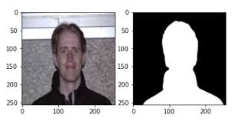
PROJECT TITLE
HUMAN SEGMENATION USING U-NET
3/21/2024 Annual Review

Slide 3


AGENDA
1.PROBLEM STATEMENT
2.PROJECT OVERVIEW
3.WHO ARE THE END USERS?
4.YOUR VALUE AND ITS VALUE PROPOSITION
5.THE WOW IN THE SOLUTION
6.MODELLING
7.RESULTS
3/21/2024 Annual Review

Slide 4

PROBLEM STATEMENT
The Need for an Human segementation using u-net
Human bodies possess intricate anatomical structures, with variations in poses, shapes, and appearances.
U-Net's ability to capture both local details and global context enables precise delineation of human subjects even amidst varying anatomical complexities.
Humans are often surrounded by cluttered backgrounds or occlusions, making it challenging to segment them accurately
U-Net's symmetric contracting and expanding paths facilitate effective background separation, resulting in clear delineation of human subjects.
U-Net's hierarchical feature extraction facilitates interpretable segmentation outputs, enhancing the usability and reliability of the system.
There is a demand for a playlist generator that can curate playlists based on the user's mood or emotions, providing a tailored music experience.
This project aims to develop an intelligent system capable of interpreting users' emotional cues and curating playlists that resonate with their feelings, thereby enhancing their music listening experience.
3/21/2024 Annual Review

Slide 5

PROJECT OVERVIEW
Overview
Human segmentation using U-Net involves employing a deep learning architecture called U-Net to accurately delineate human subjects from images or videos. U-Net, initially proposed for biomedical image segmentation, has been adapted and widely used in computer vision tasks, including human segmentation.
Goals
Develop a U-Net model achieving high precision in human segmentation across varied poses and environments, ensuring robust performance for real-world applications.
How it Works
The U-Net model learns to accurately segment human subjects from images by leveraging its hierarchical feature extraction capabilities and skip connections to capture both local details and global context, enabling precise delineation of human regions even in complex scenes.
Objectives
Ensure that the trained U-Net model generalizes well across diverse datasets, environments, lighting conditions, and camera angles, enabling its applicability in various domains and scenarios.
Enhance user experience and emotional well-being through music
3/21/2024 Annual Review

Slide 6

WHO ARE THE END USERS?
The end users of human segmentation using U-Net can vary depending on the specific application and domain. Some potential end users include:
Medical Professionals: Radiologists, doctors, and medical researchers may use human segmentation for applications such as tumor detection, organ segmentation, and disease diagnosis in medical imaging modalities like MRI, CT scans, or X-rays.
Surveillance Agencies: Security personnel, law enforcement agencies, and surveillance operators may utilize human segmentation for monitoring and analyzing video footage in surveillance systems, enabling activities such as crowd monitoring, person tracking, and threat detection.
Entertainment Industry: Film producers, game developers, and virtual reality content creators may employ human segmentation for applications such as character animation, green screen compositing, and motion capture in entertainment productions and interactive experiences.
3/21/2024 Annual Review

Slide 7

YOUR SOLUTION AND ITS VALUE PROPOSITION
HUMAN SEGMENTATION USING U-NET
The U-Net model can effectively segment human subjects from images or videos, enabling a wide range of applications in fields such as healthcare, surveillance, entertainment, and robotics.
Unique Value Proposition
Hierarchical Feature Extraction: U-Net's architecture enables hierarchical feature extraction, capturing both local details and global context in human segmentation tasks. This facilitates precise delineation of human body parts and contours, even in complex scenes with cluttered backgrounds or occlusions.
Generalization Across Domains: U-Net models generalize well across diverse datasets, environments, lighting conditions, and camera angles, ensuring their applicability in various domains and scenarios. This generalization capability enhances the versatility and usability of the model across different applications and industries.
3/21/2024 Annual Review

Slide 8

THE WOW IN YOUR SOLUTION
Highlight the unique features or aspects of your solution that make it stand out from competitors.
U-Net models generalize well across diverse datasets, environments, and conditions, ensuring applicability in various domains and scenarios.
The U-Net model can be tailored and optimized for deployment on resource-constrained edge devices such as smartphones, drones, or IoT devices.
This compatibility expands the solution's reach to remote or mobile environments, surpassing competitors in accessibility and versatility.
U-Net provides interpretable segmentation outputs, enhancing human understanding and trust in the results.
This interpretability is crucial for critical applications like medical imaging, elevating the solution's reliability and usability compared to competitors.
3/21/2024 Annual Review
8

Slide 9
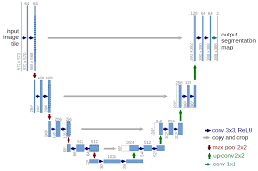
MODELLING
3/21/2024 Annual Review
9

Slide 10
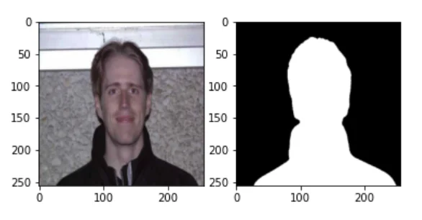
RESULTS
https://github.com/Abimaya/TNSDC-Generative-AI.git
3/21/2024 Annual Review
10

